Slide 1
SLIQ (Supervised Learning In Quest)
Student: NIKOLA Terzić
Profesor: veljko milutinović

Slide 2
SLIQ (Supervised Learning In Quest)
Decision-tree classifier for data mining
Design goals:
  Able to handle large disk-resident training sets
  No restrictions on training-set size

Slide 3
Building tree
MakeTree(Training Data T)
Partition(T)
END_MakeTree
Partition(Data S)
if(all points in S are in the same class)
return;
Evaluate Splits for each attribute A;
Use best split to partition S into S1 and S2;
Partition(S1);
Partition(S2);
END_Partition

Slide 4

Evaluating Split Points
The gini index is used to evaluate the “goodness” of the alternative splits for an attribute
If a data set T contains examples from n classes, gini(T) is defined as
$$gini\left(T\right)=\sum{{pj}^{2}}$$
where p_{j} is the relative frequency of class j in T
After splitting T into two subset T1 and T2 with n₁ & n₂ tuples each
$$gini\left(T\right)=\frac{n1}{n}∗gini\left(T1\right)+\frac{n2}{n}∗gini(T2)$$

Slide 5
Pre-Sorting
Before we start to build a tree we need to sort data

Slide 6
Finding Split Points
For each attribute A do
  evaluate splits on attribute A using attribute list
Keep split with lowest GINI index

Slide 7
Finding Split Points
Initialize class-histograms of left and right children;
for each record in the attribute list do
find the corresponding entry in Class List and the class and Leaf node
evaluate splitting index for value(A) < record.value;
update the class histogram in the leaf

Slide 8
Finding Split Points

Slide 9
Implementation
C++
Pre-Sorting is done on GPU (CUDA)

Slide 10
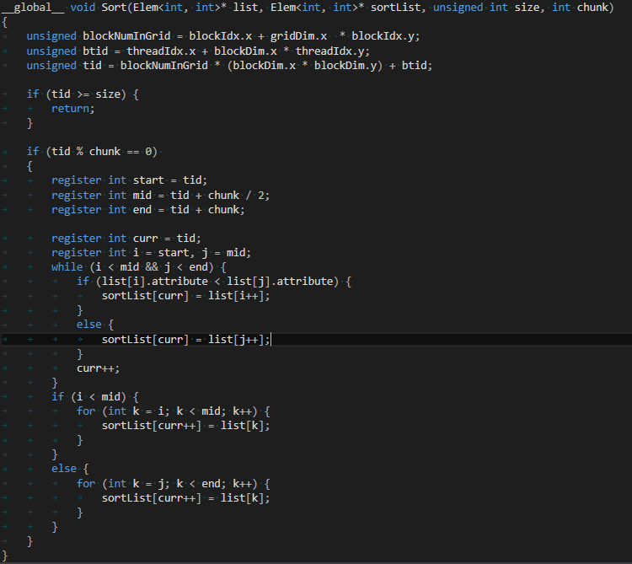

Slide 11
RESULTS

